Slide 1
Opening a Brazilian Restaurant in Rio de Janeiro, Brazil

Slide 2
Análise de projeto slide 2
Coursera Capstone
Business Problem
Results section
Brazilian
Restaurant
Target Audience and Data
Discussion section
Methodology
Conclusion

Slide 3

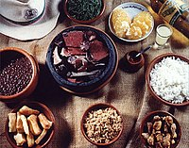
Análise de projeto slide 2
Business Problem
The objective of this capstone project is to analyse and select the best locations in the city of Rio de Janeiro, Brazil to open a new Brazilian Restaurant. Using data science methodology and machine learning techniques like clustering, this project aims to provide solutions to answer the business question: where would you recommend that they open it?

Slide 4
Análise de projeto slide 2
Target Audience/Data
Target Audience
- Travellers and residents who want to have an experience to try Brazilian Food.
- Business personnel who are planning to invest in a restaurant
Data
- Name of the 167 Neighboors, from web scrapping
https://pt.wikipedia.org/wiki/Lista_de_bairros_da_cidade_do_Rio_de_Janeiro
- Latitude and longitude coordinates of those neighbourhoods. This is required in order to plot the map and also to get the venue data
- Use Foresquare Data to obtain info about restaurants, We will use this data to perform clustering on the neighbourhoods.

Slide 5
Análise de projeto slide 3
Methodology
Get the geographical coordinates
Predictive Modeling
Data Scraping
K-Mean
We will do web scraping using Python pandas to extract the list of neighbourhoods data. I organized the CSV file in Excel and upload the file to my notebook.this is just a list of names. .
using the package Geocode
converted the neighbourhoods into their equivalent latitude and longitude values.
visualize the neighbourhoods in a map using Folium package.
.
Analyze the restaurants fo Each Neighborhood
I have to define ideal Number of clusters, and the doing the Kmeans Clustering
Using K-mean to clustering data neighborhoods with most common restaurant in each Neighborhood.

Slide 6
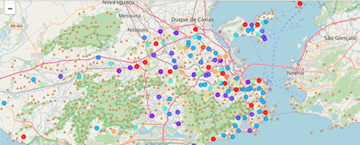
Análise de projeto slide 4
Results

Slide 7
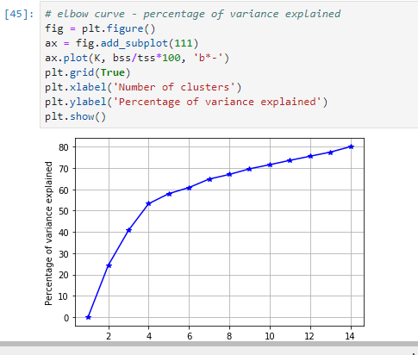
Análise de projeto slide 5
Results
Predictive Modeling - fourteen clusters are ideal

Slide 8
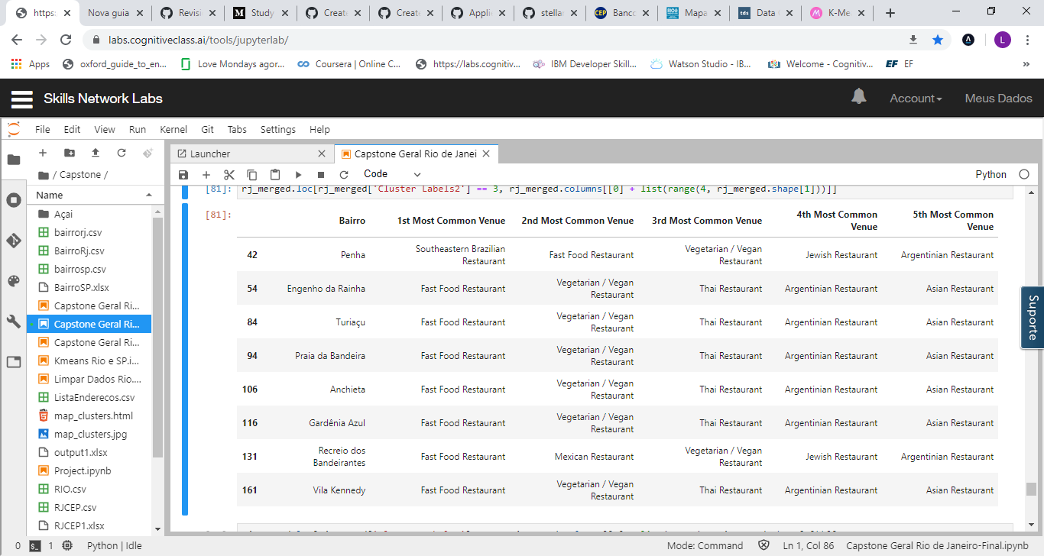
Análise de projeto slide 5
Results
The answer proposed by this project is: The neighbourhoods in cluster 3,6,7,8 and 13 are the most preferred locations to open a Brazilian Restaurant
Cluster 3

Slide 9
Análise de projeto slide 5
Results
Cluster 6

Slide 10
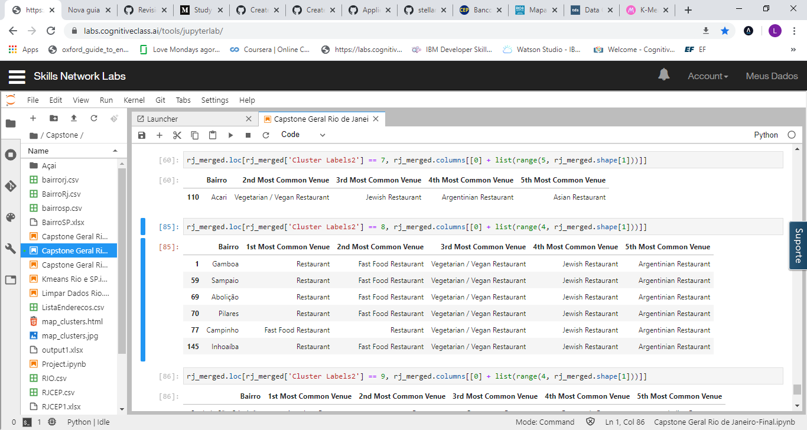
Análise de projeto slide 5
Results
Cluster 7
Cluster 8

Slide 11
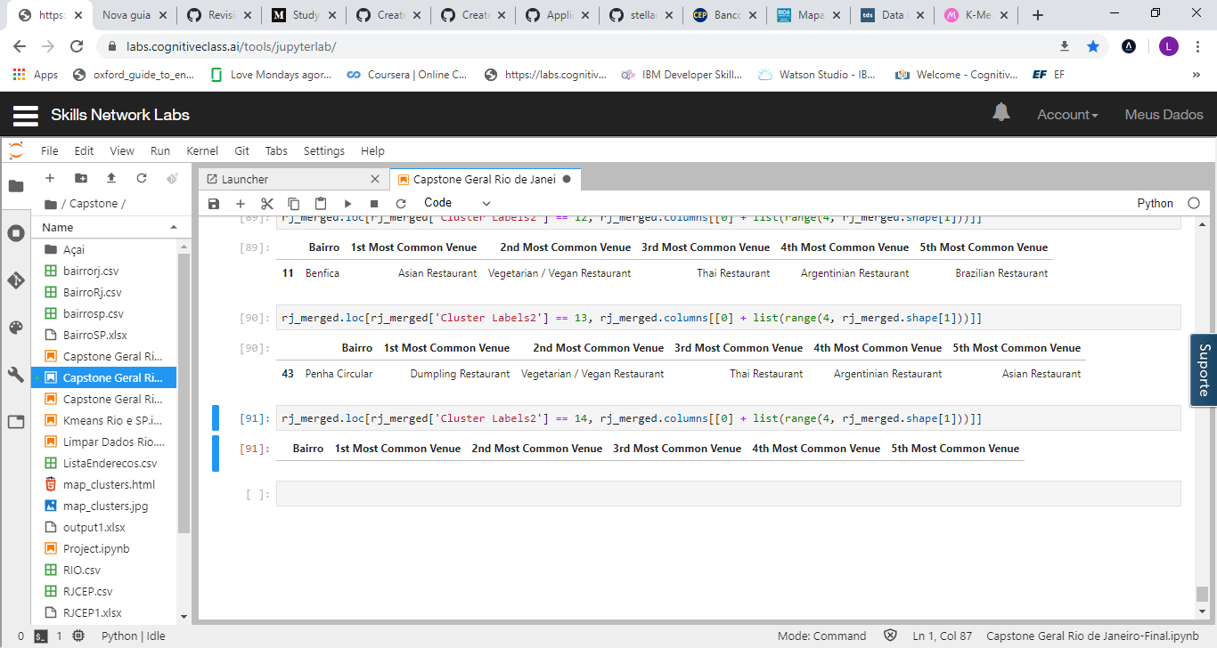
Análise de projeto slide 5
Results
Cluster 13

Slide 12
Análise de projeto slide 8
Discussion Section
Database problems. Per example: The Copacabana has just two Brazilians Restaurants, The classification of restaurants has problems as well, the most common type of restaurant is “restaurant”. The vegetarian restaurant appears in a lot of neighborhoods, we don´t see in Brazil too much old people vegetarian, the young people has preference with this kind of restaurant, they have more affinity with technology, the people who update the app are the youngest, we have this bias in the database.
Based the database for each Neighborhood above, I believe that classification for each cluster can be done better with calculation of restaurants (most common) in each
Neighborhood. Refering to each cluster, I can't achieve clearly what represent in each cluster by using Foursquare - Most Common Restaurant data.
Rio de Janeiro is a Big City is a big city with a high population density in a narrow área and high income difference In this project, we only consider one factor i.e. frequency of occurrence of Restaurants there are. other factors such as population and income of residents that could influence the location decision

Slide 13
Análise de projeto slide 6
Conclusion
I would like to conclude saying this project gave me the opportunity to use python and applying the data science methodologies in a real problem. For this Project, I used CRISP-DM, I learned how important is to know and validate the data, I have gone through the process of identifying the business problem, specifying the data required, extracting and preparing the data, performing machine learning by clustering the data into 14 clusters based on their similarities, and lastly providing recommendations to the relevant stakeholders regarding the best locations to open a Brazilian restaurant.
The answer proposed by this project is: The neighbourhoods in cluster 3,6,7,8 and 13 are the most preferred locations to open a Brazilian Restaurant.

Slide 14
Thank you

